Slide 1
NEXTHIKES IT SOLUTIONS NLP PROJECT :- DISASTER TWEET CLASSIFICATION
t4
BY:- NAMAN SHARMA.

Slide 2
PROJECT OVERVIEW
DATA ANALYSIS
EDA
Disaster Non-Disaster Tweets
Characters used in disaster and non-disaster tweets.
Pair Plot
Disaster Word Cloud
Machine Learning Algorithms
Model Accuracy
Deep Learning Algorithm
NLP.py , Streamlit.
Agenda

Slide 3
Project Overview
In today's digital age, social media platforms like Twitter play a crucial role in disseminating information, especially during emergencies and disasters. However, distinguishing between tweets that genuinely indicate a disaster and those that do not can be challenging, even for humans. As a result, there is growing interest from various organizations, such as disaster relief agencies and news outlets, in developing automated methods to monitor Twitter for real-time disaster alerts

Slide 4
Data Analysis
Data Overview
Total Entries: 7613
Total Features: 5
Data Exploration
Missing Value /NAN Value Analysis
2533 in location missing/nan values.
63 in keyword

Slide 5
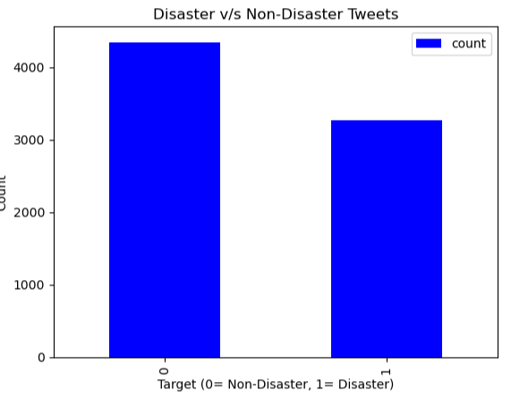
Disaster v/s Non-Disaster Tweets
1. It shows the frequency count of Disaster and Non-Disaster Tweets.
2. The Non-Disaster tweets are represented by 0 whereas Disaster tweets are shown by 1.
3. The Non-Disaster tweets are around 4500.
4. The Disaster tweets are around 3500.

Slide 6
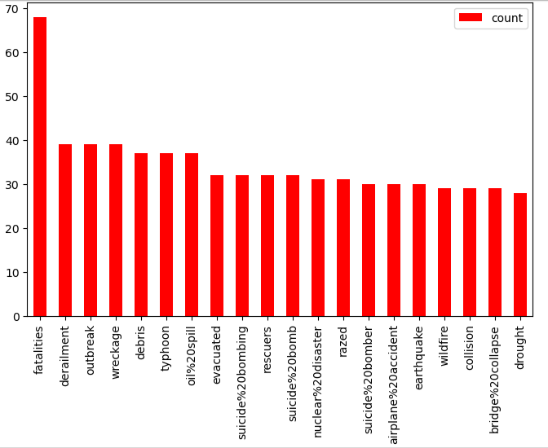
Top 20 Keyword in Disaster Tweets
This bar plot reveals the top 20 keywords most frequently associated with disaster-related tweets.
It highlights key themes such as "fatalities", "damage", and "evacuation", which are crucial indicators for identifying real disaster events in text data.

Slide 7
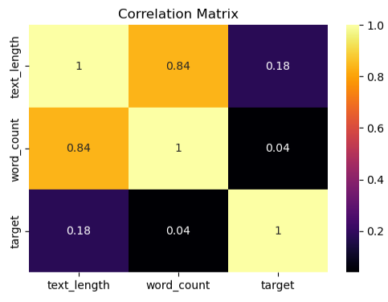
Correlation Matrix
This correlation heatmap shows a moderate positive correlation between text_length and word_count.
However, both text_length and word_count have very weak correlations with target.
Suggesting that tweet length or word count alone is not a strong predictor of whether a tweet is about a disaster.

Slide 8
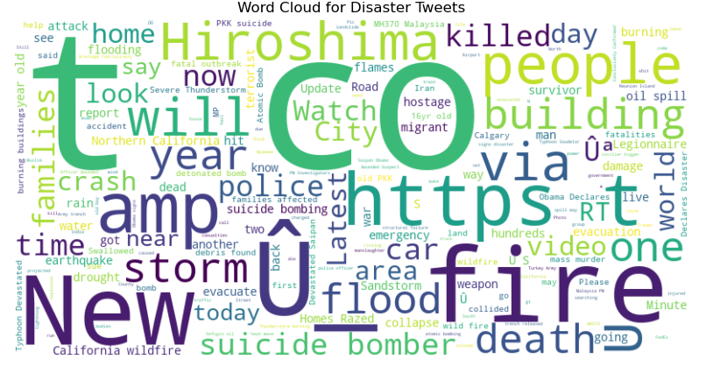
Word Cloud for Disaster Tweets
The Word Cloud reveals the most frequent terms in disaster-related tweets.
Prominent words such as "Fire," "Emergency," "Storm," "Suicide Bomber" dominate, reflecting the urgent and critical language commonly used during actual disasters.

Slide 9
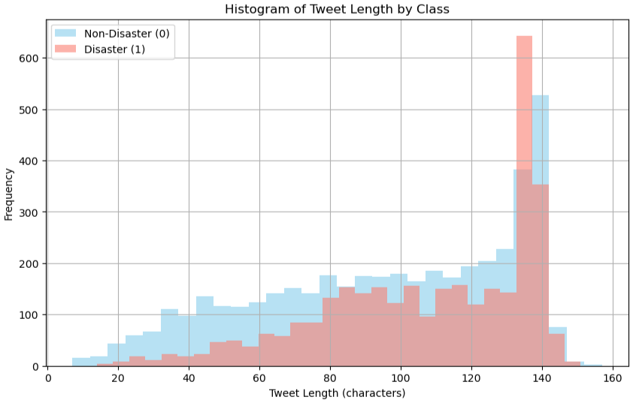
Histogram: Tweet Length by Target Class
This histogram shows that disaster tweets tend to be slightly longer than non-disaster tweets.
Both distributions are right-skewed, with most tweets under 150 characters, but disaster tweets have a longer tail.

Slide 10
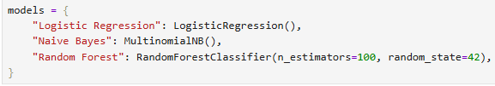
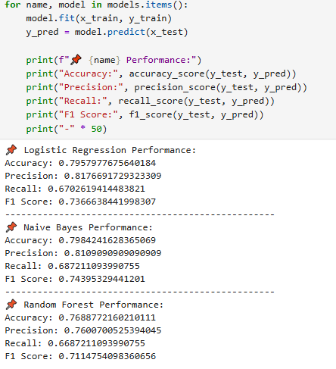
Model Training and Evaluation
Among the tested models, Logistic Regression and Naive Bayes generally offer high precision and balanced performance for disaster tweet classification.

Slide 11
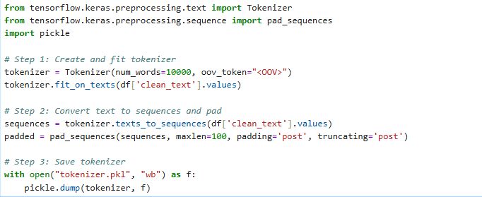
Using Deep Learning Algorithms

Slide 12
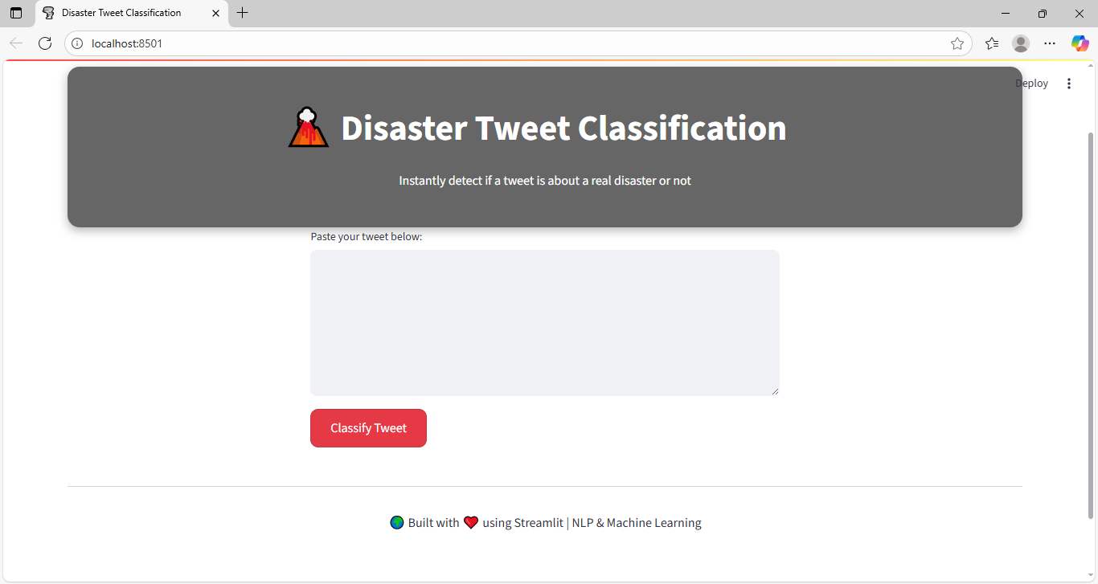
Deployment with Web Interface

Slide 13
References
Scikit-learn: https://scikit-learn.org
NLTK: https://www.nltk.org
TextBlob: https://textblob.readthedocs.io
Word Cloud Library: https://github.com/amueller/word_cloud
Word Cloud Library: https://github.com/amueller/word_cloud

Slide 14
Concept and Techniques
TF-IDF Vectorization
Logistic Regression, Random Forest, Naive Bayes
Model Evaluation Metrics (Precision, Recall, F1-Score, ROC)
Flask/Streamlit for Web Deployment
Pickle Serialization for Models

Slide 15
THANK YOU.

